Slide 1
WELCOME GRADE 6
SAMINA ASHRAF

Slide 2
Pakistan School, Kingdom Of Bahrain
NEW BOOK
Subject : Mathematics Grade: 6
Chapter: 6 CIRCLES
LESSON: 1 Pg.123
TOPIC : CIRCUMFERENCE OF THE CIRCLE.
(IF DIAMETER IS GIVEN )

Slide 3
Objective:
At the end of the session students will be able to:
Solve daily life problems regarding the circumference of the circle ,if the diameter is given.

Slide 4
WHAT IS PI ? Pg.#123

Slide 5
EXAMPLES Pg.123

Slide 6
Page # 124
Q.# 9. Find the circumference of circle , when diameter is 28 cm.(Take π = 22/7 )
Formula
Circumference = π x d
= 22/7 x 28
= 88 cm
Answer

Slide 7
Daily Life Problem Plenary
The diameter of a pond is 30 m. Find its circumference.(π = 3.14)
Circumference = π x d

Slide 8
SOLUTION
The diameter of a pond is 30 m. Find its circumference.(π = 3.14)
Circumference = π x d
= 3.14 x 30
= 94.20 m
or = 94.2 m
Answer

Slide 9
HOME WORK Page # 124
Solve Q.# 8 ( a ) and Q.# ( 10 ).
Fore more practice solve the same questions with π = 22/7.

Slide 10
STAY HOME
STAY SAFE

Slide 13
Pg : 120

Slide 14
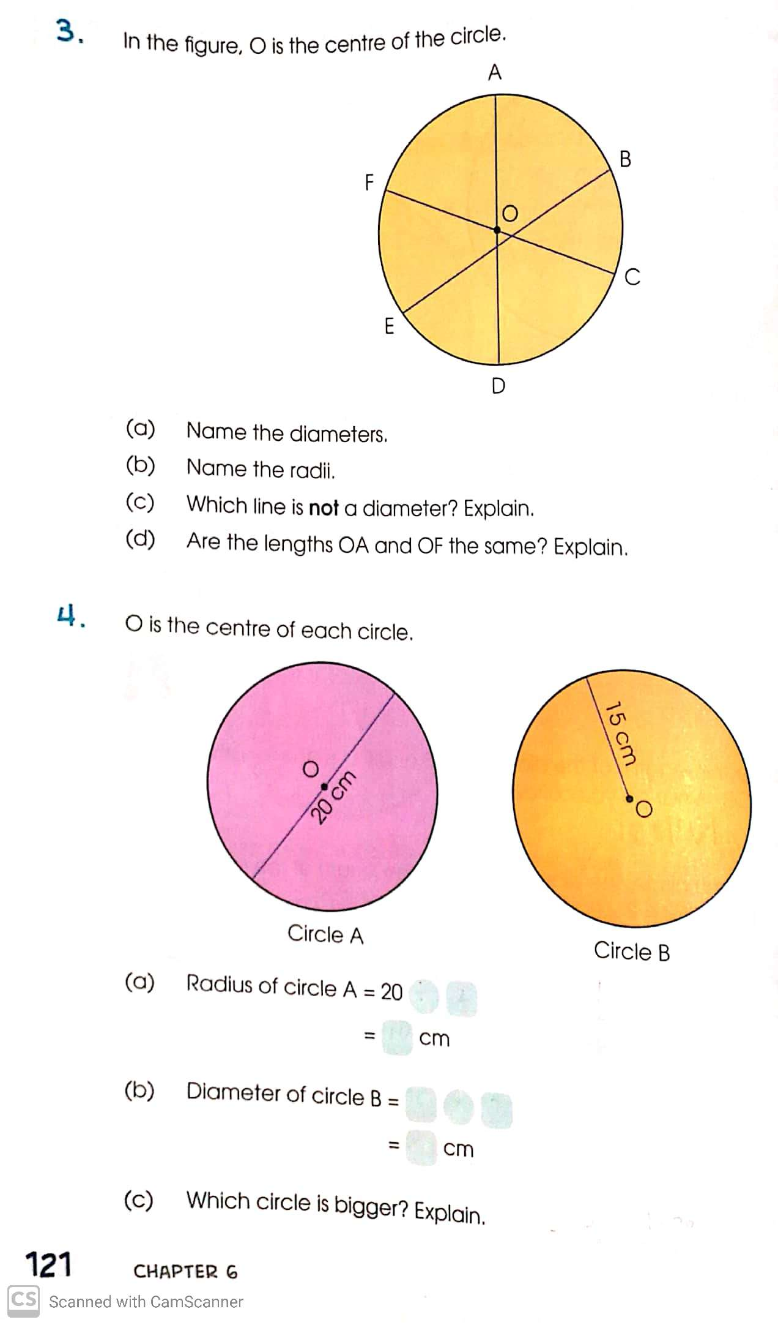

Slide 16
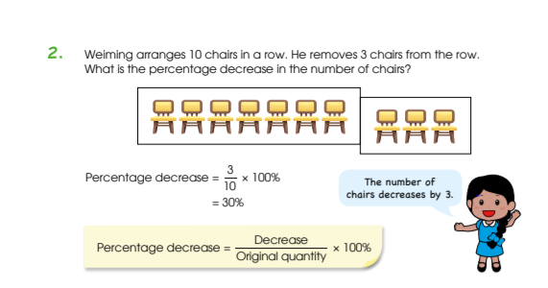
Pg : 100

Slide 17
Pg : 101
20
20
20

