Slide 1
WELCOME GRADE 7
Pg. 030
Topic :
Addition and Subtraction
involving negative numbers
Samina Ashraf

Slide 2
Objective:
At the end of the session students will be able to:
Solve real life problems involving Negative
Numbers.

Slide 3
RULES FOR ADDTION AND SUBTRACTION OF INTEGERS
3 + 4 = 7
- 3 - 4 = - 7
- 3 + 4 = 1
3 – 4 = - 1

Slide 4
RULES FOR MULTIPLICATION OF INTEGERS
( 3) X (4) = 12
(-3) X ( - 4) = 12
(3) x( - 4) = - 12
(-3) x (4) = - 12

Slide 5
ANSWERS OF Q.#5 Pg.# 037
Q.5. Evaluate each of the following.
a) 22 – (– 13) = 35
b) – 14 – 16 = – 30
c) – 19 – (–11) = – 8
d) – 18 – (–22) = 4
e) 17 – 23 = 6
f) – 20 – 15 = – 35
g) 12 – (– 17) = 29
h) – 21 – 17 = – 38

Slide 6
REAL LIFE PROBLEMS
Page # 037
Q.6. The temperature of a village on a particular
night is –11⁰C. The next morning, the temperature rises by 7 ⁰C. Find the temperature in the morning.
Solution:
Temperature at night = – 11 ⁰C
Temperature rises next morning = 7 ⁰C
Temperature in the morning = – 11 ⁰C + 7 ⁰C
= – 4 ⁰C
Ans.

Slide 7
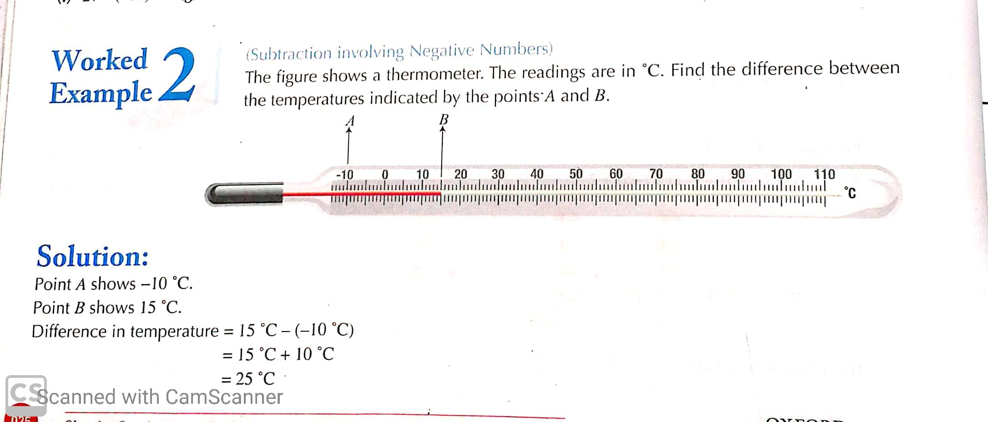
Pg. 035

Slide 8
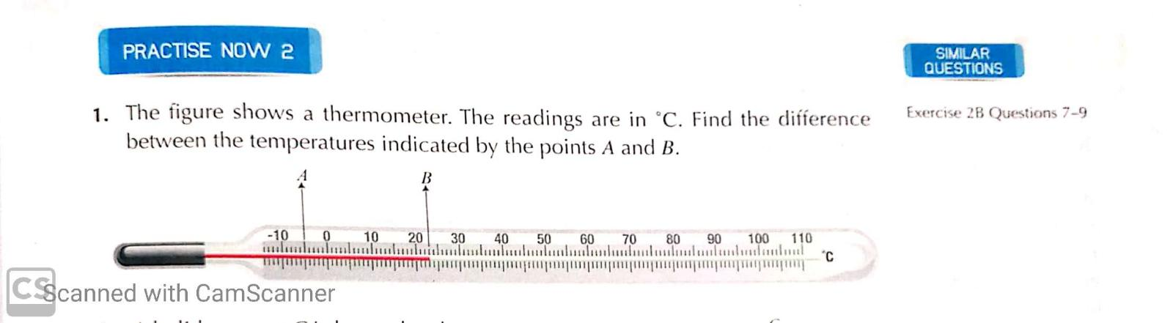
PLENARY
Pg. 036

Slide 9
Pg.# 037
Q. 4. Find the value of each of the following.
(a) 23 + ( - 11 )
= 23 – 11
= 12
Ans.

Slide 10
(b) - 19 + 12
= - 7
Ans.
(c) 17 + (- 29)
= 17 - 29
= - 12
Ans.

Slide 11
PLENARY
Pg.# 037
Q.# 4
Solve: ( Any 3 parts )
(d) - 21 + ( - 25 )
(e) - 13 + 18
(f) - 24 + ( - 13)
(g) 16 + ( - 27)

Slide 12
ANSWERS
Solve: ( Any 3 parts )
(d) - 21 + ( - 25 ) = - 46
(e) - 13 + 18 = 5
(f) - 24 + ( - 13) = - 37
(g) 16 + ( - 27) = - 11

Slide 13
HOME WORK
Solve question # 5 (Any four parts ). Pg.# 037
For more practice solve Q.# 5 (All parts).

Slide 14
STAY HOME
STAY SAFE

Slide 15
Exercise 2B Page # 037
Q.3. Find the value of each of the following.
(a) 4 + (- 7 ) – (-3 )
= 4 – 7 + 3
= 4 + 3 – 7
= 7 – 7
= 0
Ans.

Slide 16
- 3 – 5 + ( -9 )
= - 3 – 5 – 9
= - 8 – 9
= - 17
Ans.

Slide 17
(c) 1 – 8 – ( - 8 )
= 1 - 8 + 8
= 1 + 8 – 8
= 9 – 8
=1
Ans.

Slide 18
PLENARY
Solve Q.3. parts d and e.
Pg. # 037

Slide 19
HOME WORK
Solve question # 3 parts f , g and h. Page # 037

